Slide 1

Fitness Guide
Under the Guidance of
Pondugala Bhaskar Rao, Asst. Professor
Department of Computer Science & Engineering
B V Raju Institute of Technology, Narsapur
Presented by
K. V. Pavan Kumar, 16211A05C8
L. A. RadhaKrishna Das, 16211A05D3
M. Nikhil Pavan Sai, 16211A05D6

Slide 2
Abstract
Abstract
Introduction
Modules
Flow Chart
Class Diagram
Software/Hardware Requirements
Screenshots
Conclusion
Future Enhancement
References
Fitness Guide :
“Respect your body. It’s the only one you get.”
Fitness Guide Application is user friendly application which keeps the user healthy.
There are thousands of fitness-related smartphone applications available for free and purchase, but there is uncertainty if these apps help individuals achieve and maintain personal fitness.

Slide 3
Abstract
Abstract
Introduction
Modules
Flow Chart
Class Diagram
Software/Hardware Requirements
Screenshots
Conclusion
Future Enhancement
References
Our app performs information collection, diagnosis, treatment and monitoring.
The objective of this paper is to share our experience with rolling out a mobile health and fitness app.

Slide 4
Abstract
Introduction
Modules
Flow Chart
Class Diagram
Software/Hardware Requirements
Screenshots
Conclusion
Future Enhancement
References
Abstract
Introduction
Existing System
Proposed System
Software requirements
Architecture Model
Modules
UML Diagrams/ER Diagrams/Flow Charts
References
Introduction
Fitness Guide is an Android application which helps you to maintain proper health depending on your BMI.
Proper health can be given by providing proper diet and by performing appropriate workouts.
This app uses your BMI(Body Mass Index) and will provide the diet and workouts accordingly.

Slide 5
Modules
Abstract
Introduction
Modules
Flow Chart
Class Diagram
Software/Hardware Requirements
Screenshots
Conclusion
Future Enhancement
References
Login
BMI calculator
Cardio
Diet
Workout
Analysis/Progress

Slide 6
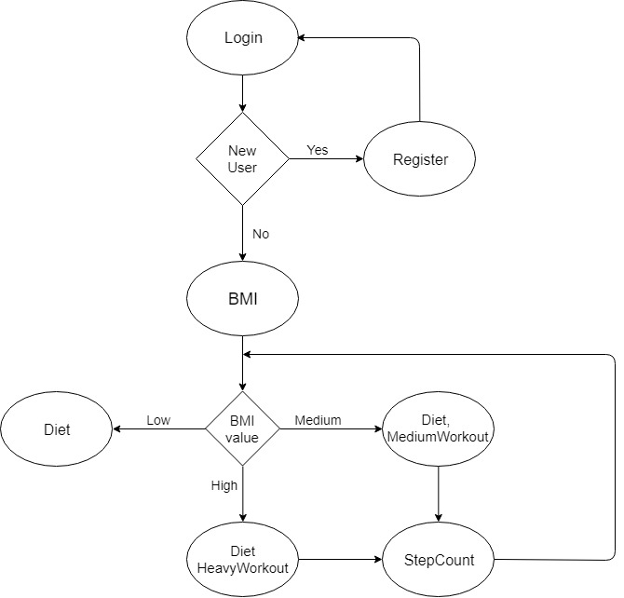
Flow Chart
Abstract
Introduction
Modules
Flow Chart
Class Diagram
Software/Hardware Requirements
Screenshots
Conclusion
Future Enhancement
References

Slide 7
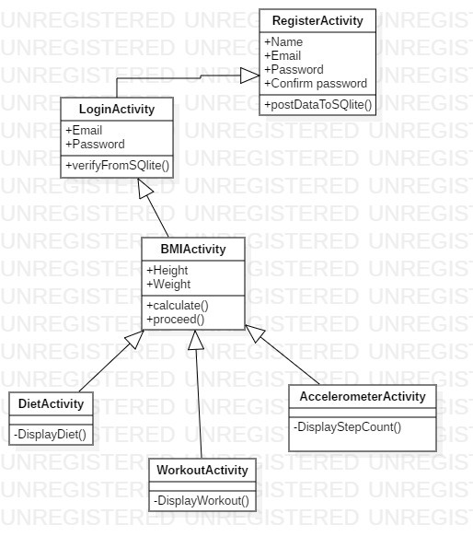
Class Diagram
Abstract
Introduction
Modules
Flow Chart
Class Diagram
Software/Hardware Requirements
Screenshots
Conclusion
Future Enhancement
References

Slide 8
Introduction
Existing System
Proposed System
Software Requirements
References
Abstract
Introduction
Modules
Flow Chart
Class Diagram
Software/Hardware Requirements
Screenshots
Conclusion
Future Enhancement
References
Software/Hardware Requirements
Android Studio
Java
XML
SQLite
Accelerometer sensor

Slide 9
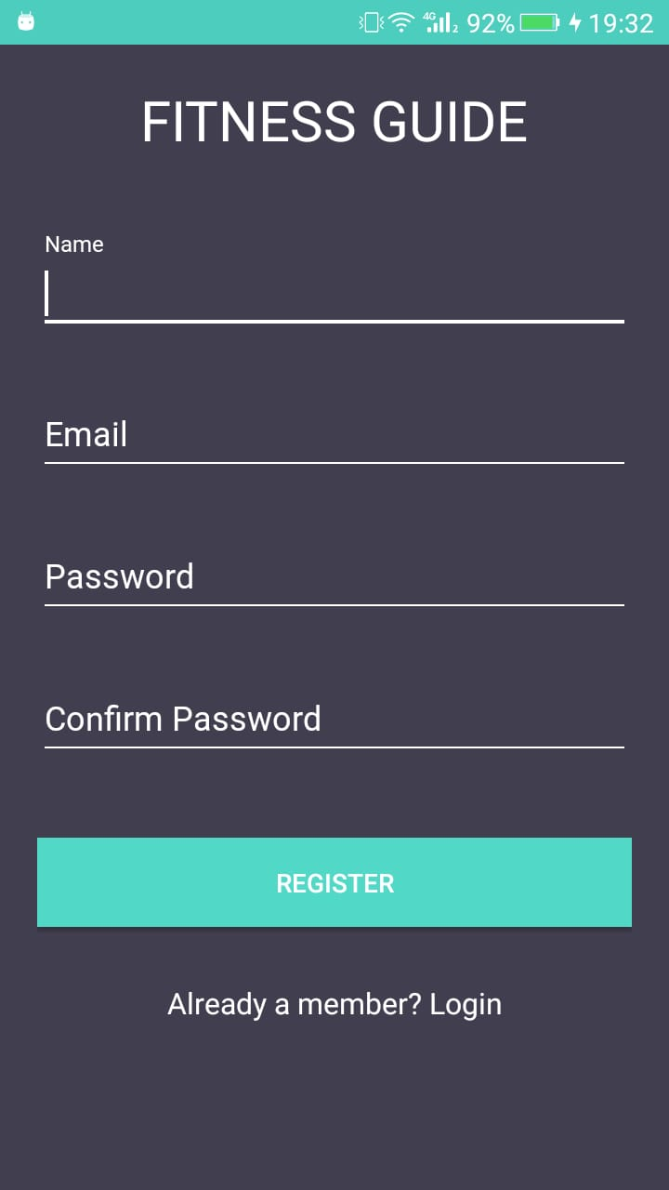
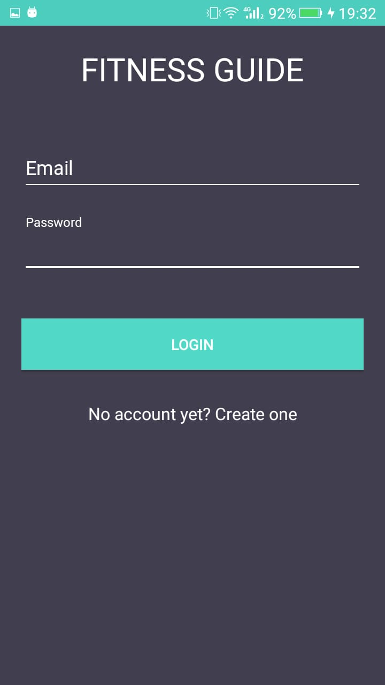
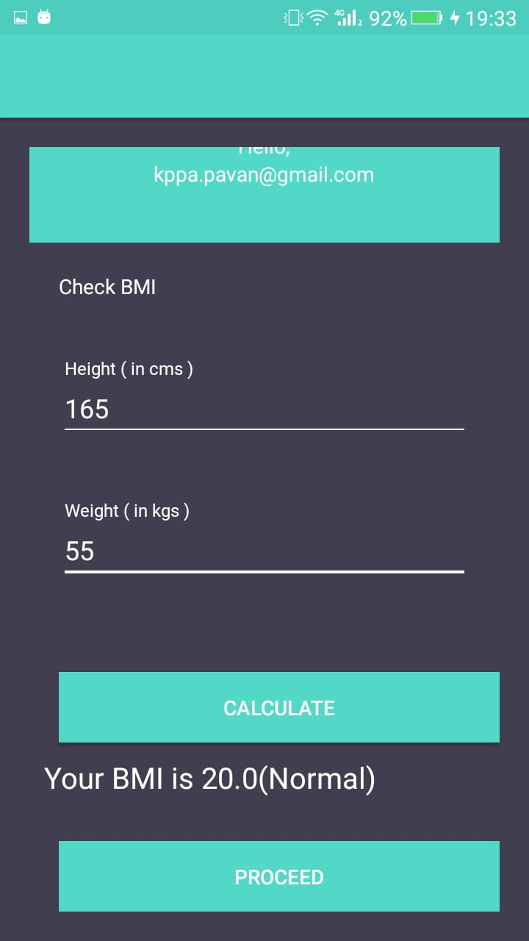
Screenshots
Abstract
Introduction
Modules
Flow Chart
Class Diagram
Software/Hardware Requirements
Screenshots
Conclusion
Future Enhancement
References
Registration Feature
Login Feature
BMI Calculation Feature

Slide 10
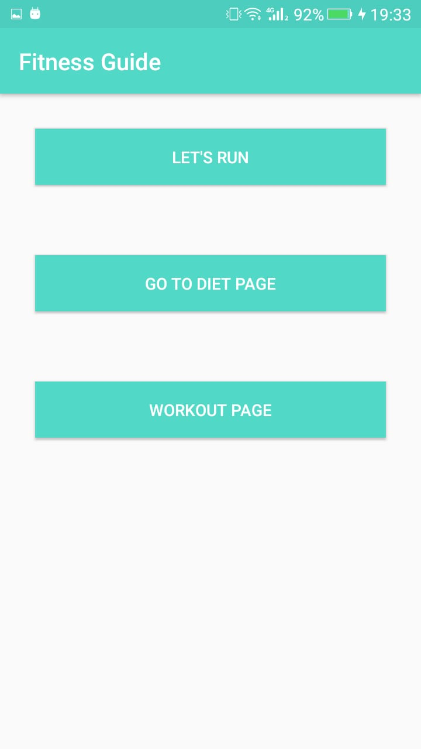
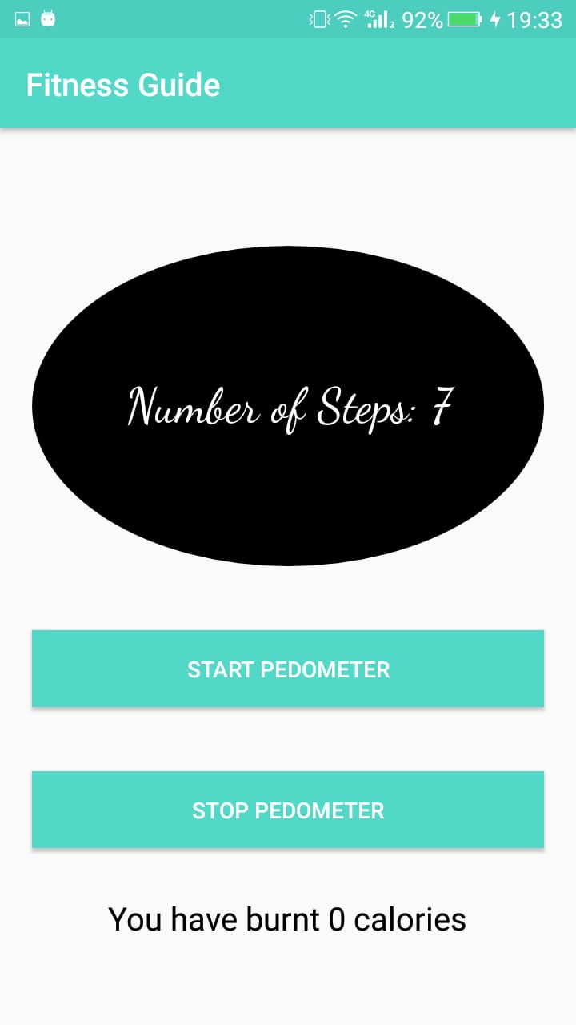
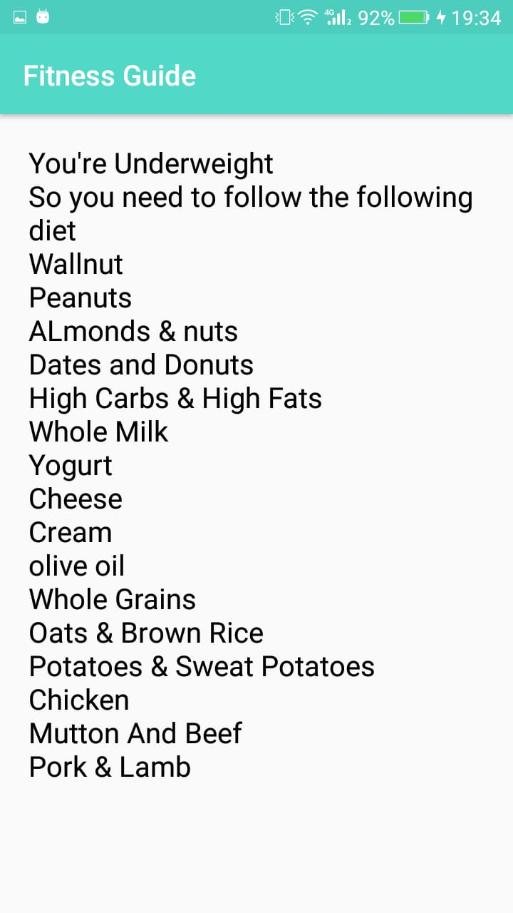
Screenshots
Abstract
Introduction
Modules
Flow Chart
Class Diagram
Software/Hardware Requirements
Screenshots
Conclusion
Future Enhancement
References
Guide Feature
Step Count Feature
Diet Feature(Low BMI)

Slide 11
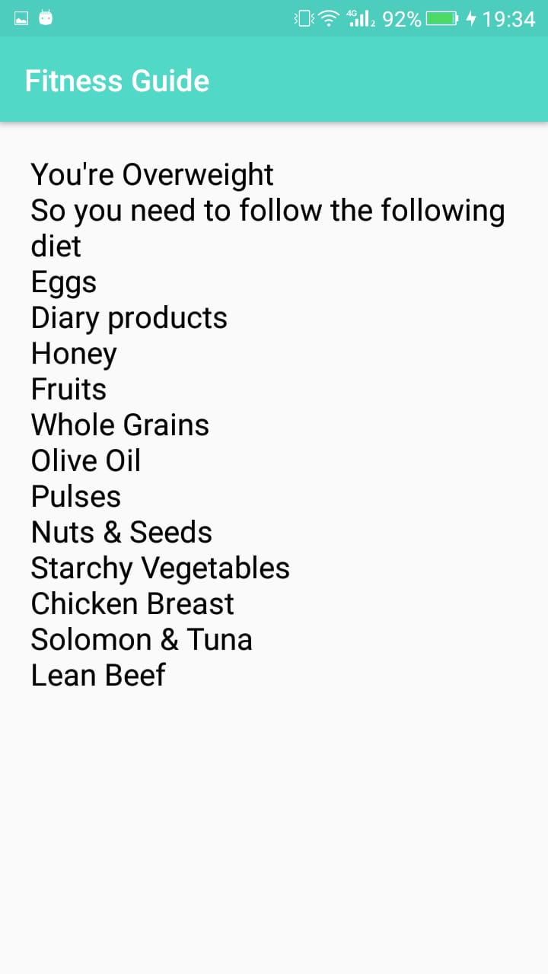
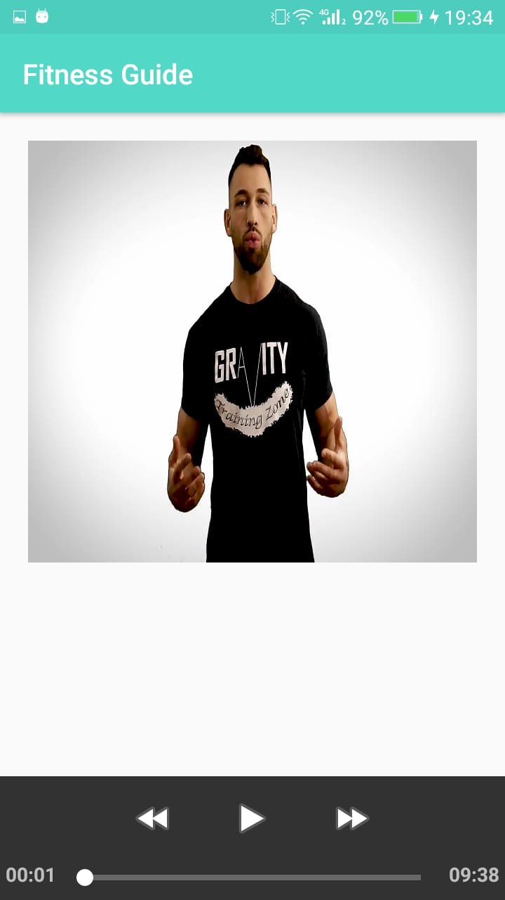
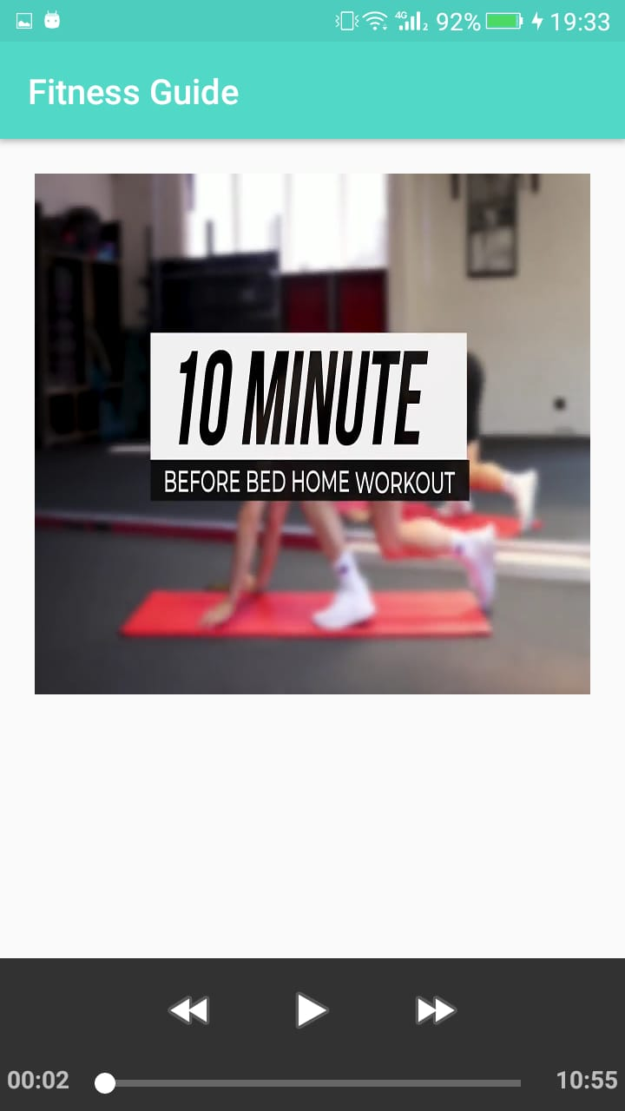
Screenshots
Abstract
Introduction
Modules
Flow Chart
Class Diagram
Software/Hardware Requirements
Screenshots
Conclusion
Future Enhancement
References
Diet Feature(High BMI)
Workout video Feature(High BMI)
Workout video Feature(Normal BMI)

Slide 12
Conclusion
Abstract
Introduction
Modules
Flow Chart
Class Diagram
Software/Hardware Requirements
Screenshots
Conclusion
Future Enhancement
References
It has been difficult to get proper diet for people now a days. So our app can help the user to even get proper diet basing on his BMI condition.
This application is completely user friendly. This only guides the user in being healthy based on his present BMI condition.
This application even helps in counting the number of steps and helps in giving accurate calculation of calories burnt.

Slide 13
Future Enhancement
Abstract
Introduction
Modules
Flow Chart
Class Diagram
Software/Hardware Requirements
Screenshots
Conclusion
Future Enhancement
References
Further we are going to add the features like day to day streak maintenance in workout.
And also we are going to implement day to day analysis and weekly analysis of the diet and workout.
And lastly we are going to give options like 30 days challenges and so on.

Slide 14
Introduction
Existing System
Proposed System
Software requirements
References
Abstract
Introduction
Modules
Flow Chart
Class Diagram
Software/Hardware Requirements
Screenshots
Conclusion
Future Enhancement
References
References
Android Studio : https://developer.android.com/docs
Android SDK :
https://developer.android.com/studio
2/1

